Slide 1

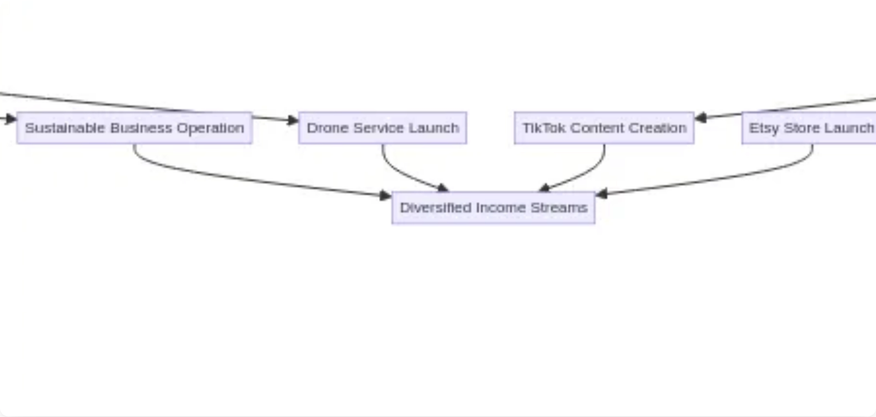
From High School to
Entrepreneurship
A Strategic Growth Plan
October 2025

Slide 2

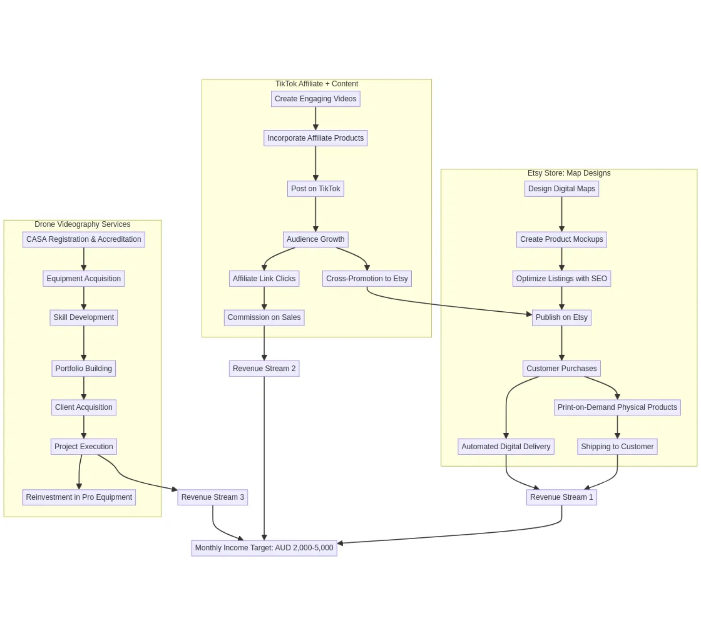
Vision & Mission
Vision
To become a
self-sufficient and innovative entrepreneur
,
leveraging creative skills in design and videography to build
multiple income streams and establish a reputable brand in
digital art and aerial media services.
Mission
To meticulously execute a
phased business development
plan
, starting with Etsy and TikTok ventures, followed by
drone videography expertise acquisition, aiming for a
sustainable monthly income of
AUD 2,000–5,000
within the
first few months of operation.

Slide 3

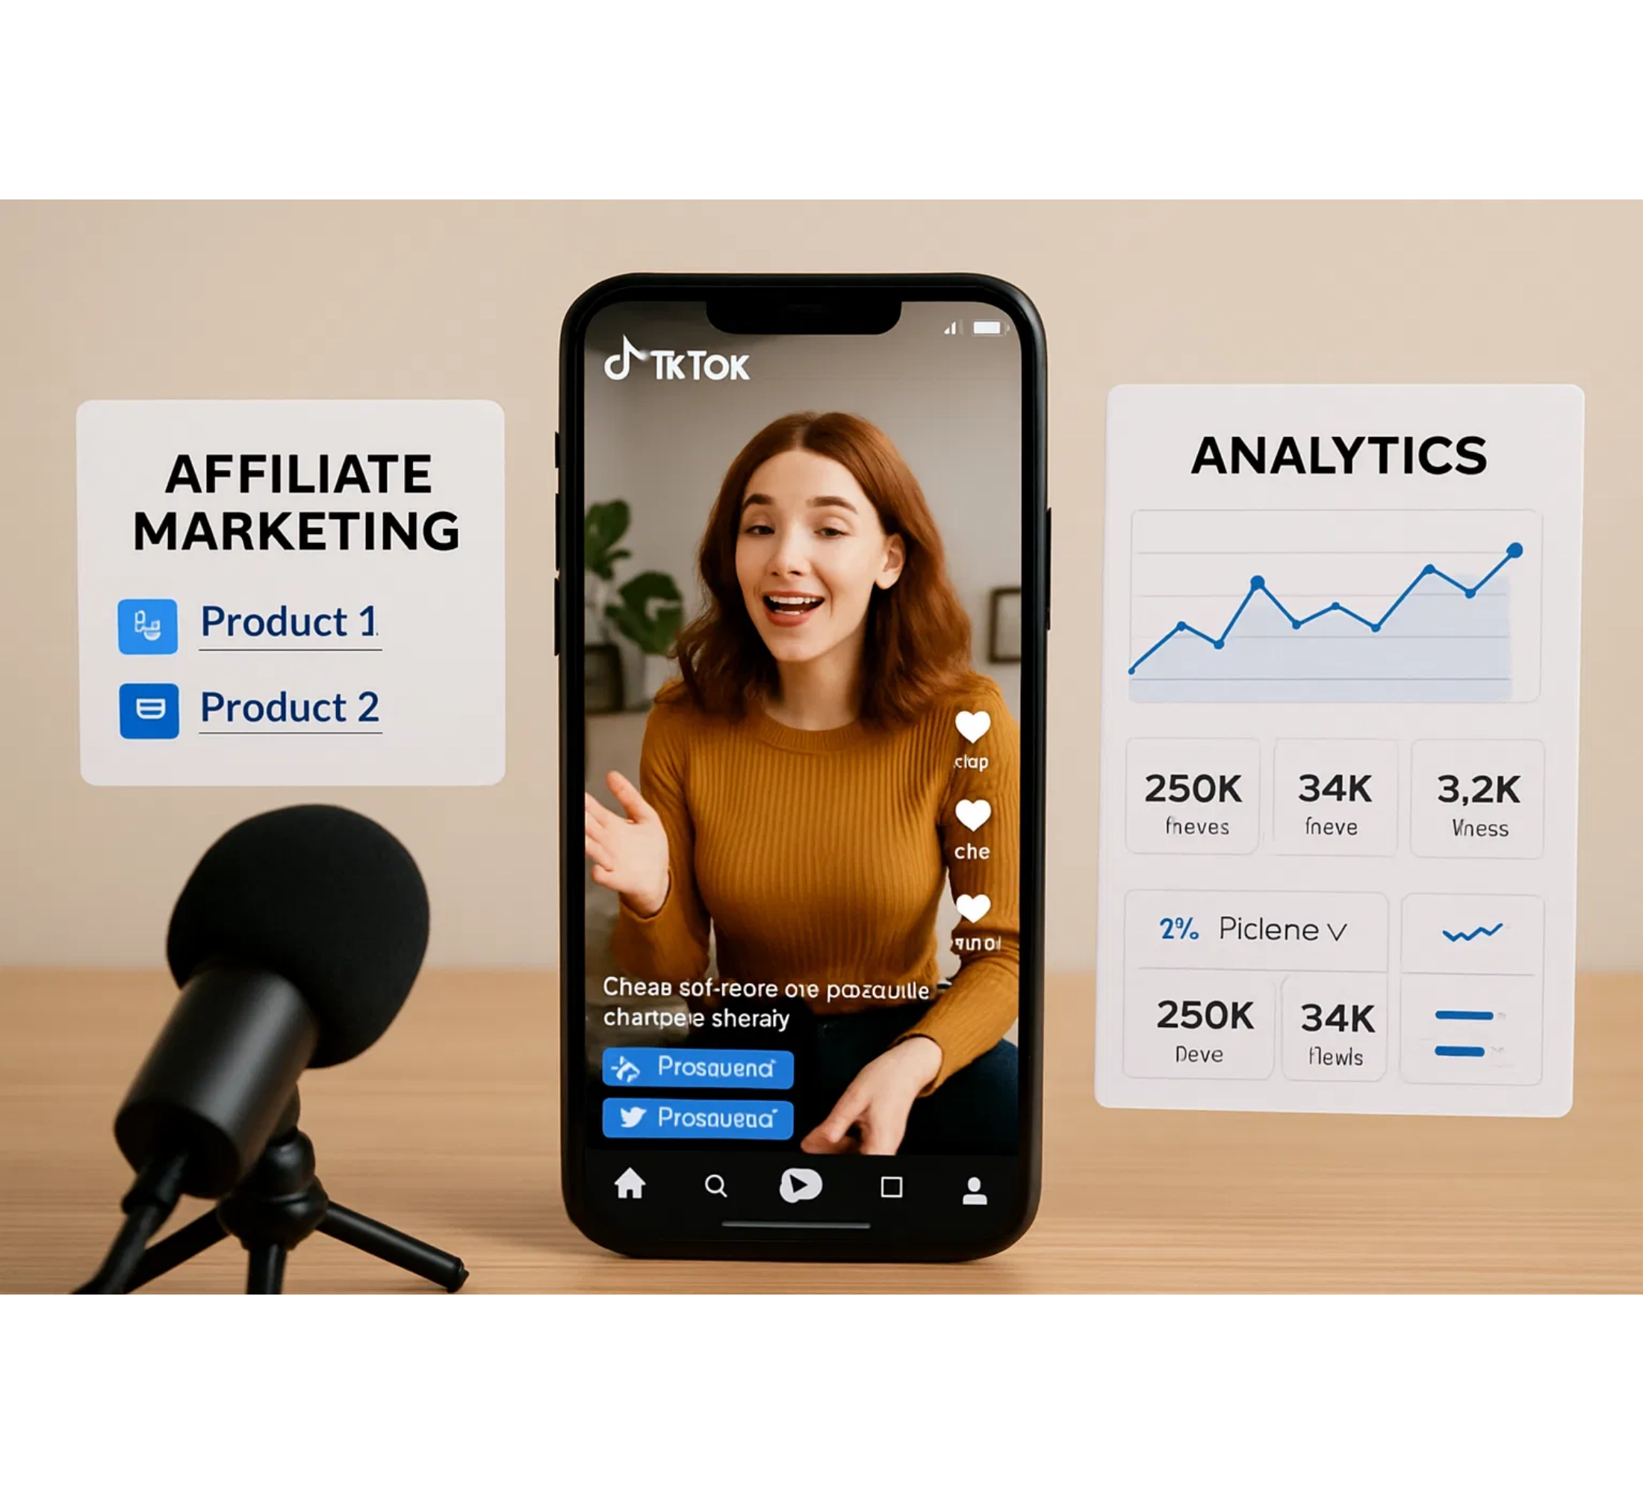
Business Models
Three Revenue Streams
A diversified approach combining digital products, content creation, and service offerings.
Etsy Store: Map Designs
Digital downloads + print-on-demand products
TikTok Affiliate + Content
Short-form videos driving affiliate sales
Drone Videography Services
Commercial aerial photography & video

Slide 4

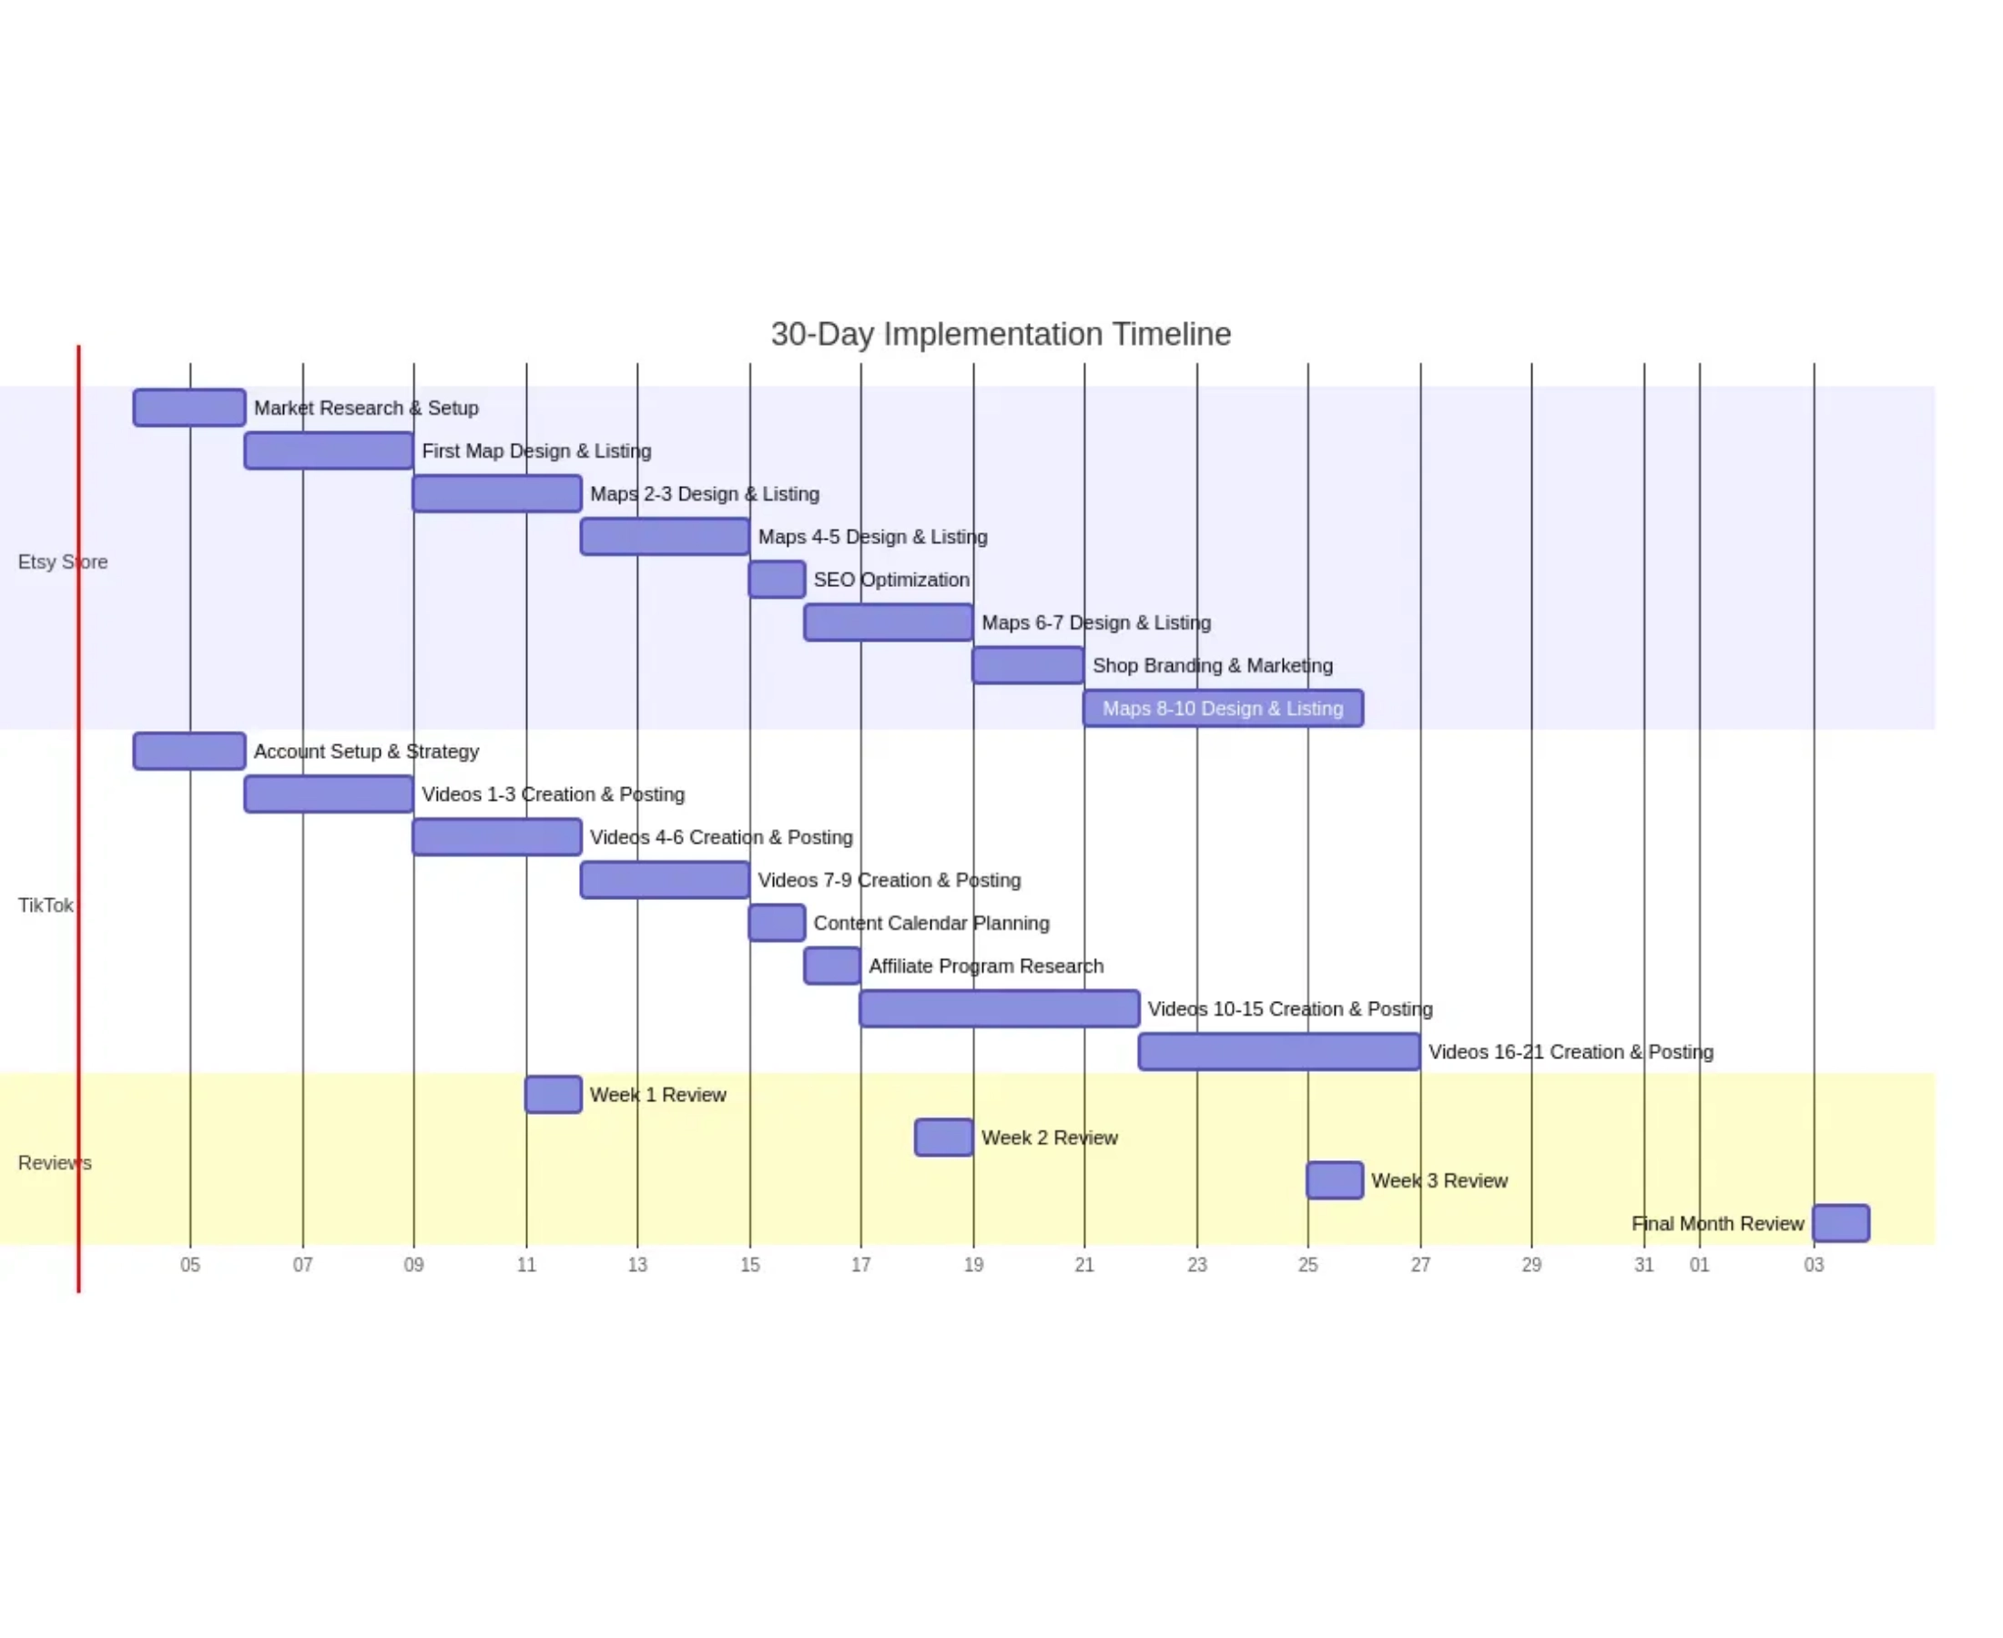
Etsy Store: Map Designs
Market Analysis
Vibrant market for
map art
with diverse styles
Digital downloads:
$15-$25
price range
Premium custom designs:
$50-$100+
Print-on-demand integration expands product offerings
Key Opportunities
Leverage existing design skills
High profit margins
on digital products
Niche specialization (minimalist, historical, fantasy maps)
Cross-promotion with TikTok content

Slide 5
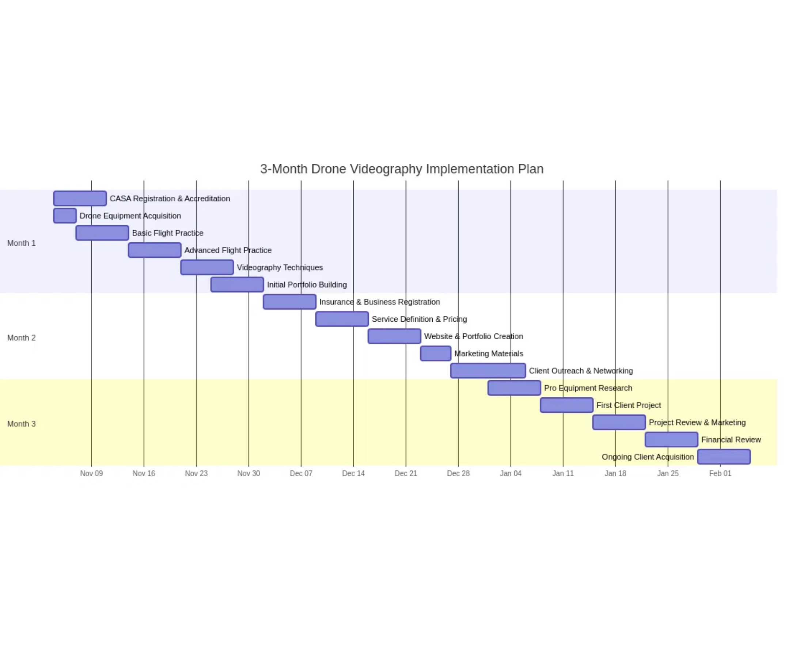






TikTok Affiliate + Content Creator
Business Model Overview
Leveraging video-editing skills to create engaging short-form content that drives affiliate sales and builds audience.
Key Opportunities
High organic reach potential for new creators
Direct conversion via TikTok Shop & affiliate links
Cross-promotion with Etsy store products
Implementation Strategy
Create 3-5 videos per week in profitable niches
Focus on personal care, tech, and home decor
Active community engagement to boost algorithm

Slide 6

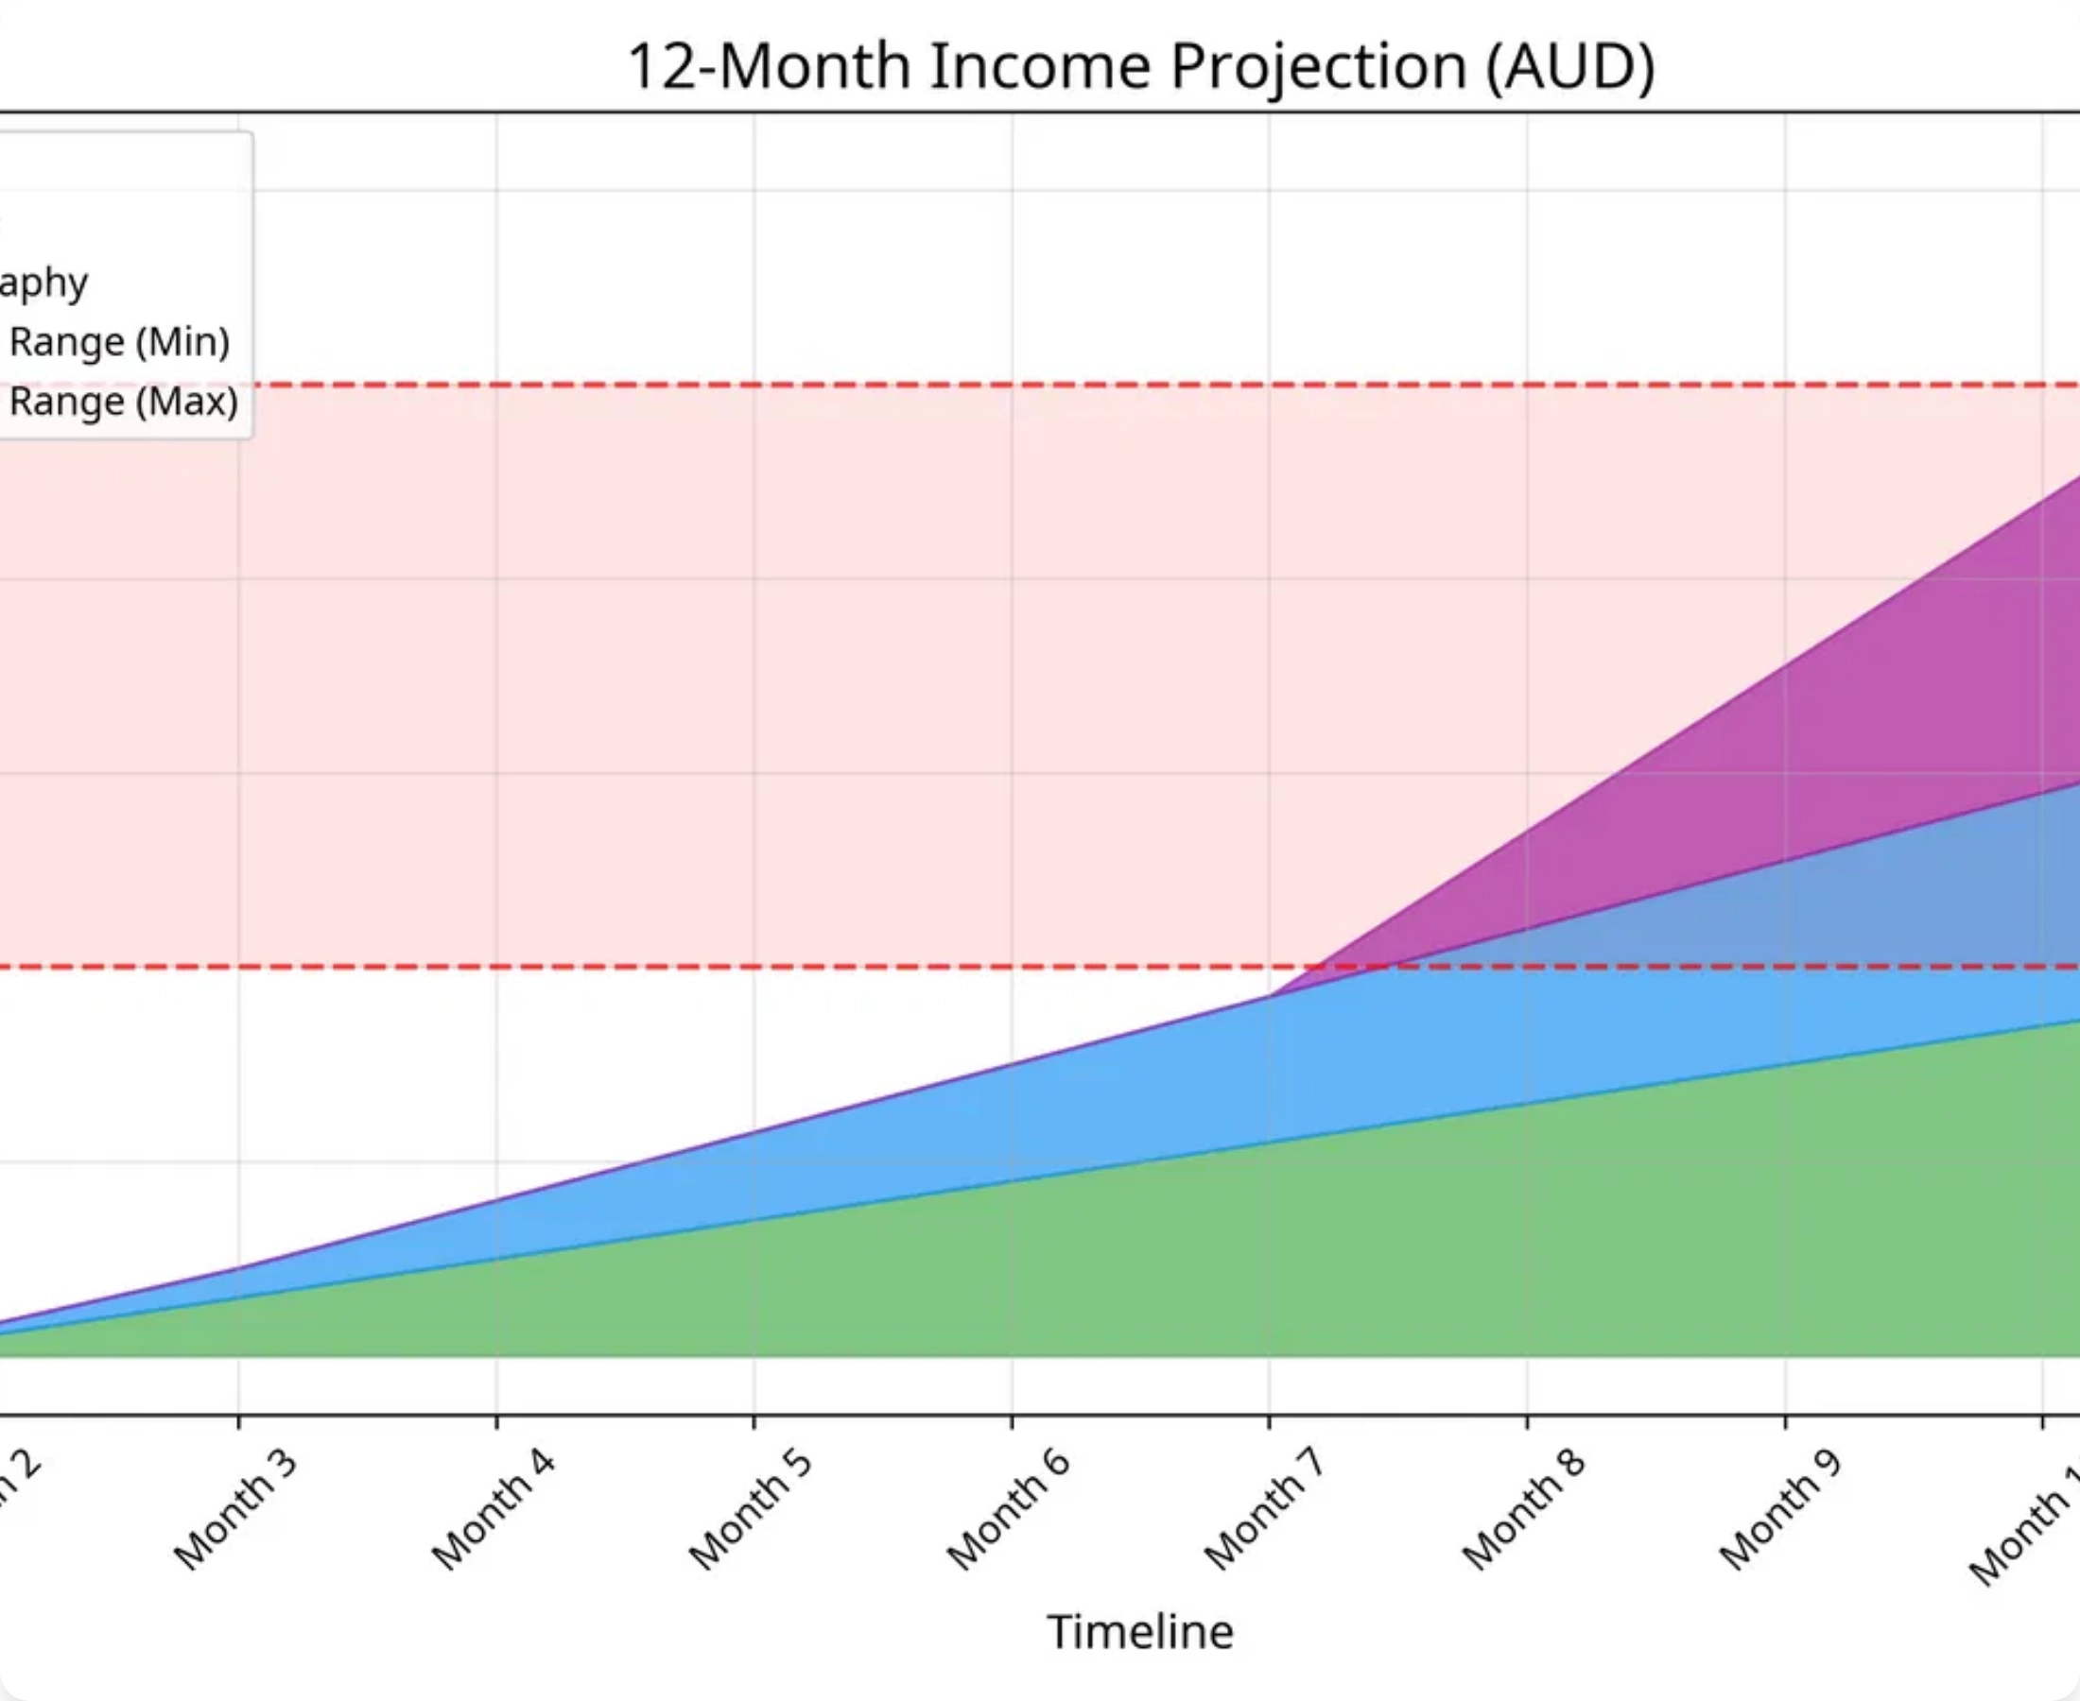
Drone Videography Services
Equipment Tiers
Starter Tier:
DJI Mini series (AUD 700-1,200) with essential accessories
Pro Tier:
DJI Mavic/Air series (AUD 2,000-4,000) for commercial projects
CASA Regulations
Mandatory registration for commercial use
Operator Accreditation for sub-2kg drones
Public liability insurance recommended
Service Offerings
Real estate aerial photography
Event videography
Landscape/tourism footage
Commercial property inspections

Slide 7

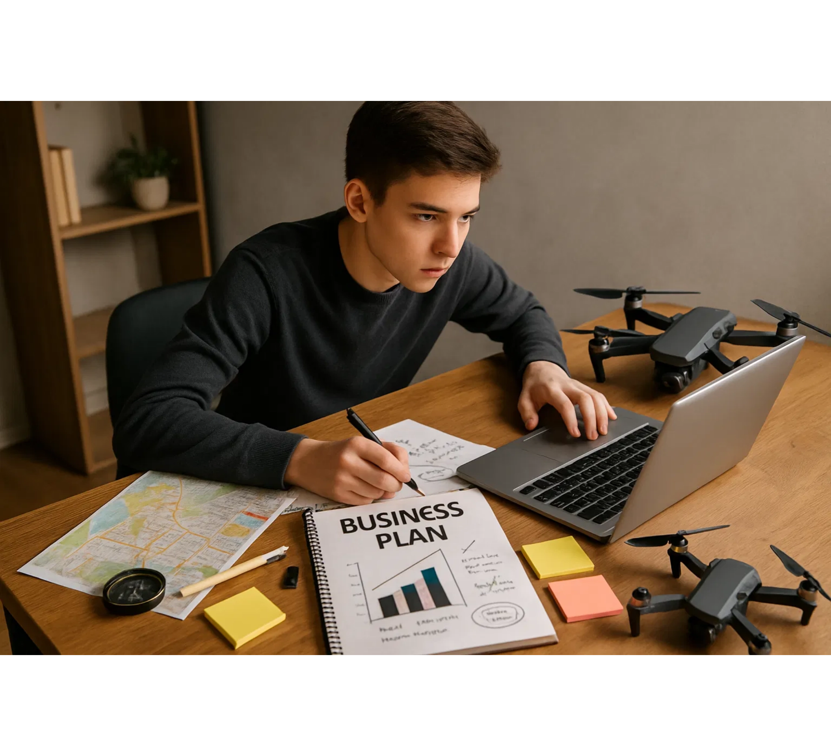
30-Day Implementation Plan
Key Milestones
Days 1-5:
Foundation
Market research, shop setup, first product creation and initial TikTok content
Days 6-14:
Product Expansion
Create 5 more map designs, optimize listings, develop TikTok content strategy
Days 15-28:
Optimization & Growth
SEO refinement, affiliate program integration, consistent content creation
Days 29-30:
Review & Planning
Performance analysis, strategy adjustment, next month planning

Slide 8

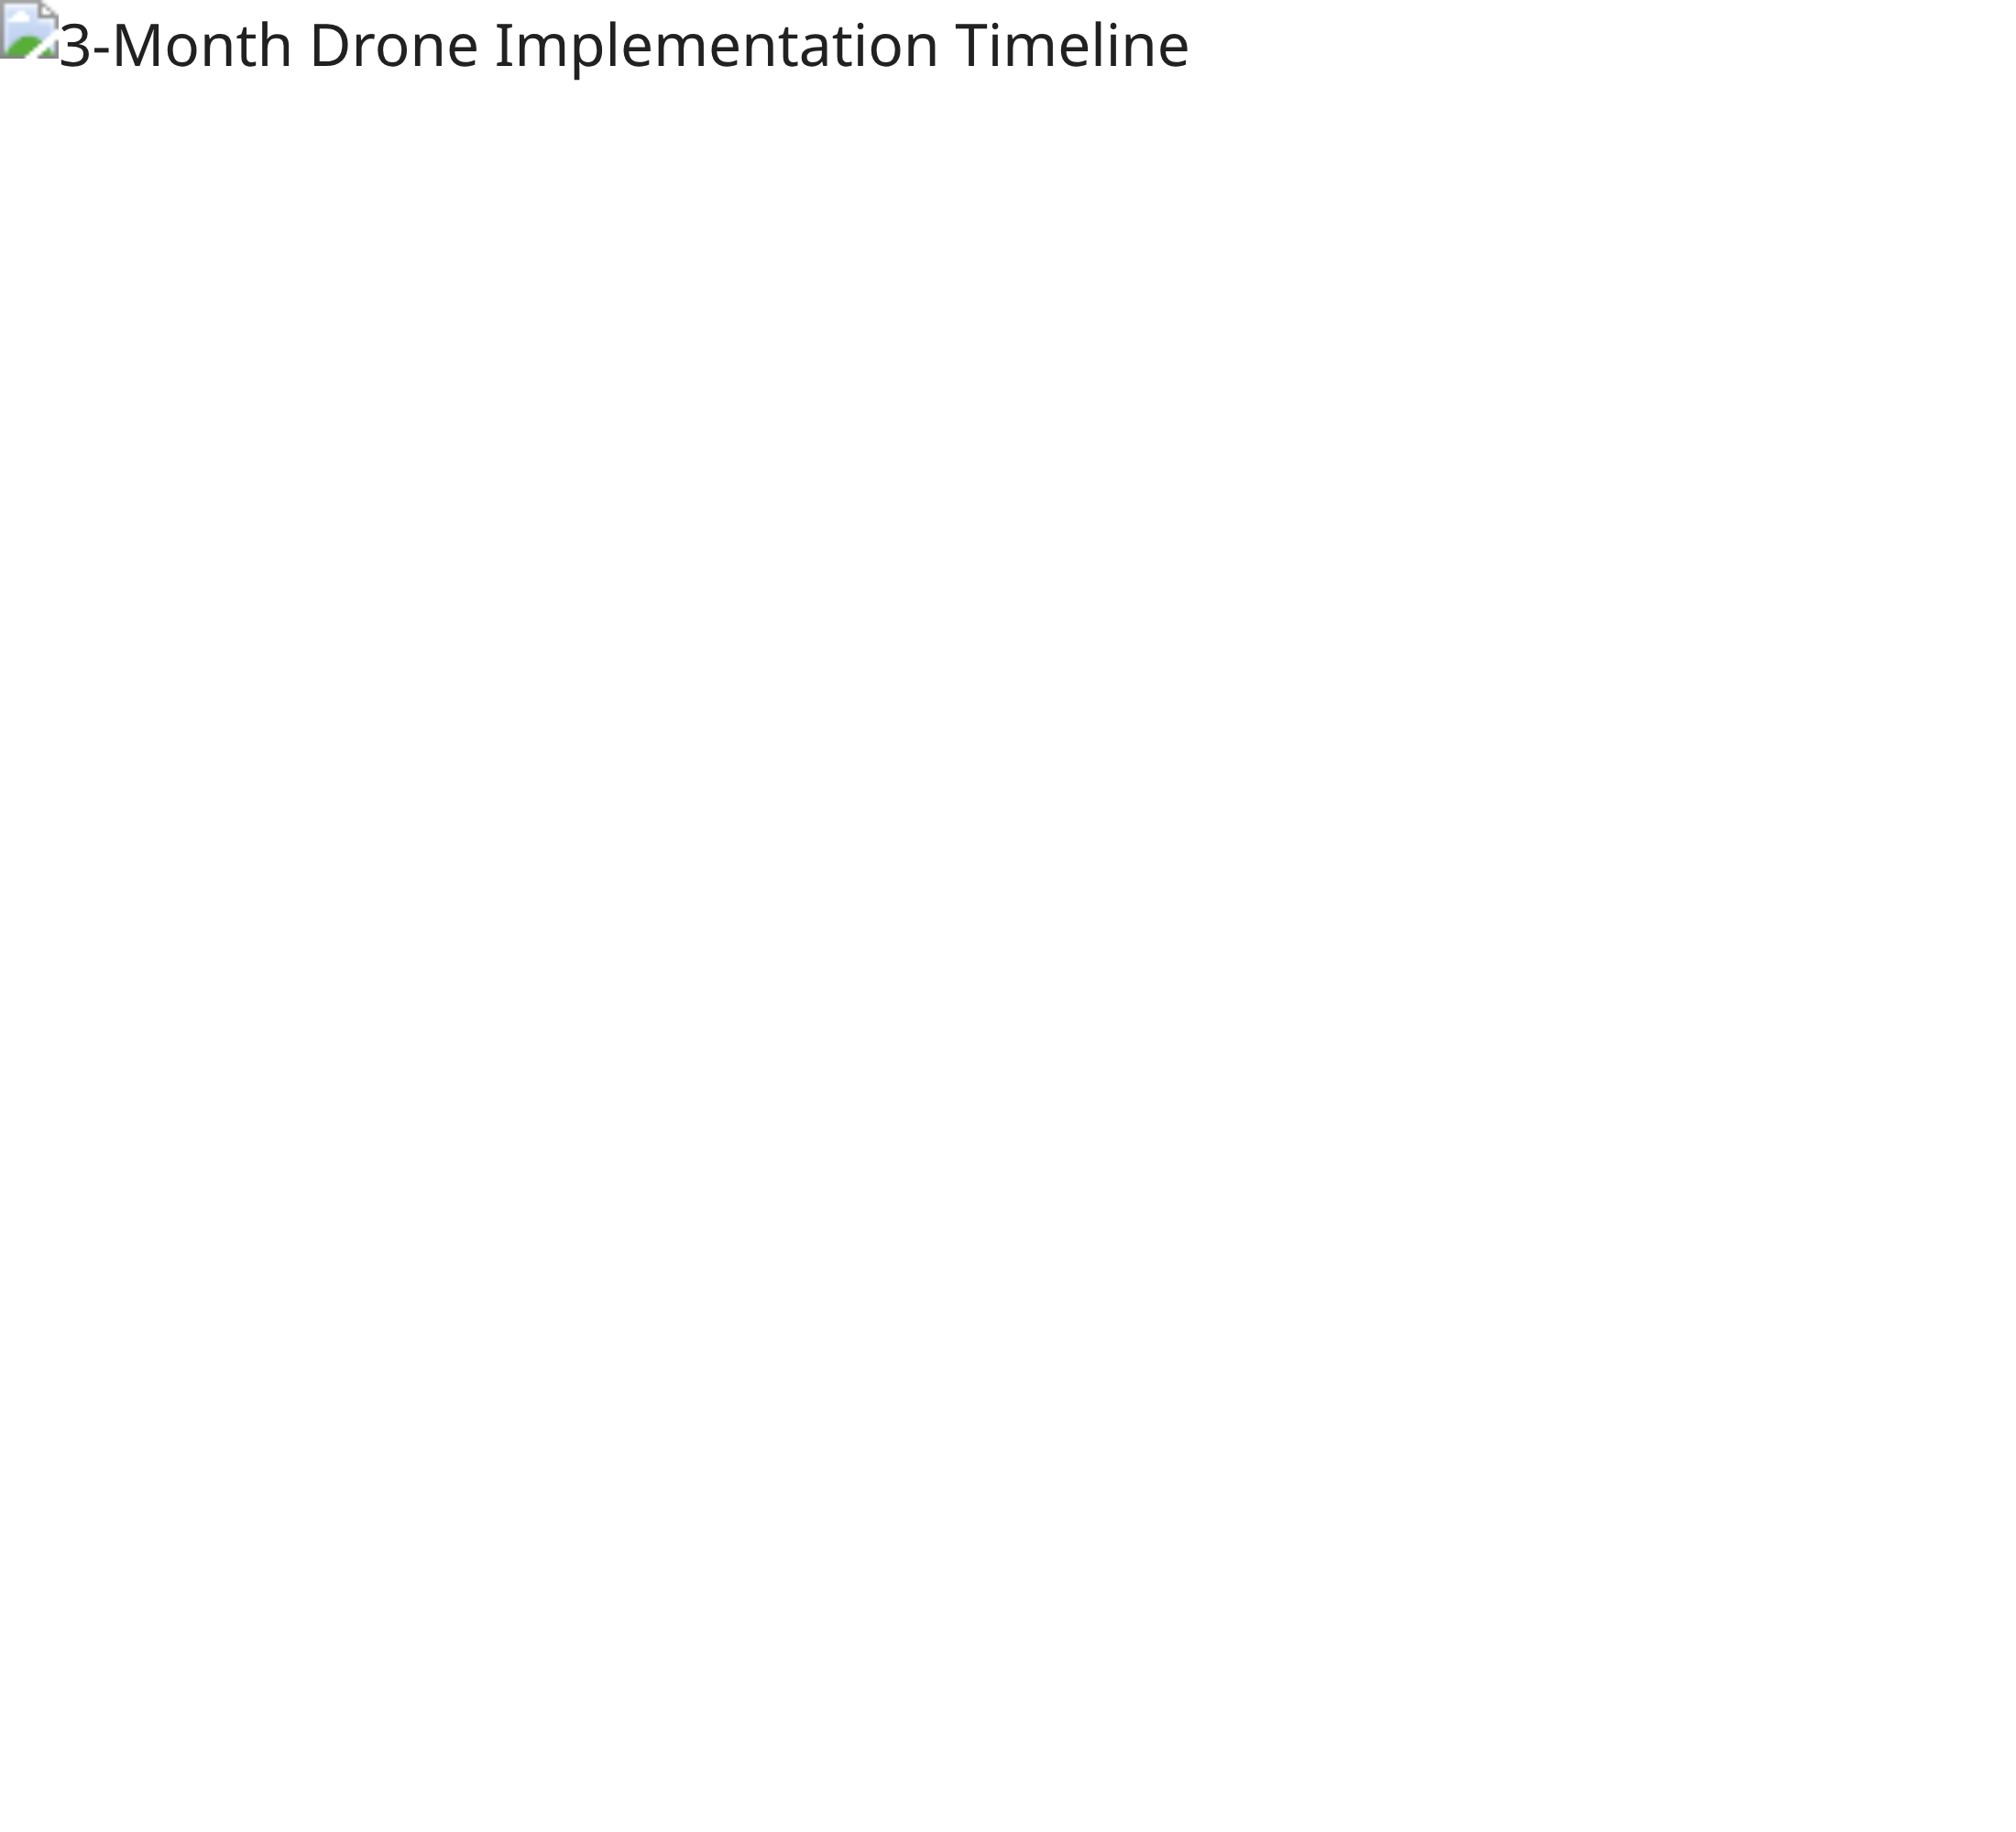
3-Month Drone Implementation
Implementation Phases
Month 1:
Learning & Practice
CASA registration, equipment acquisition, basic flight practice, and videography techniques
Month 2:
Business Setup
Insurance, business registration, service definition, portfolio creation, and initial client outreach
Month 3:
First Projects
First client project execution, testimonial collection, financial review, and ongoing client acquisition
Target:
Complete first paid project by end of Month 3, with
clear path to pro-tier equipment upgrade

Slide 9
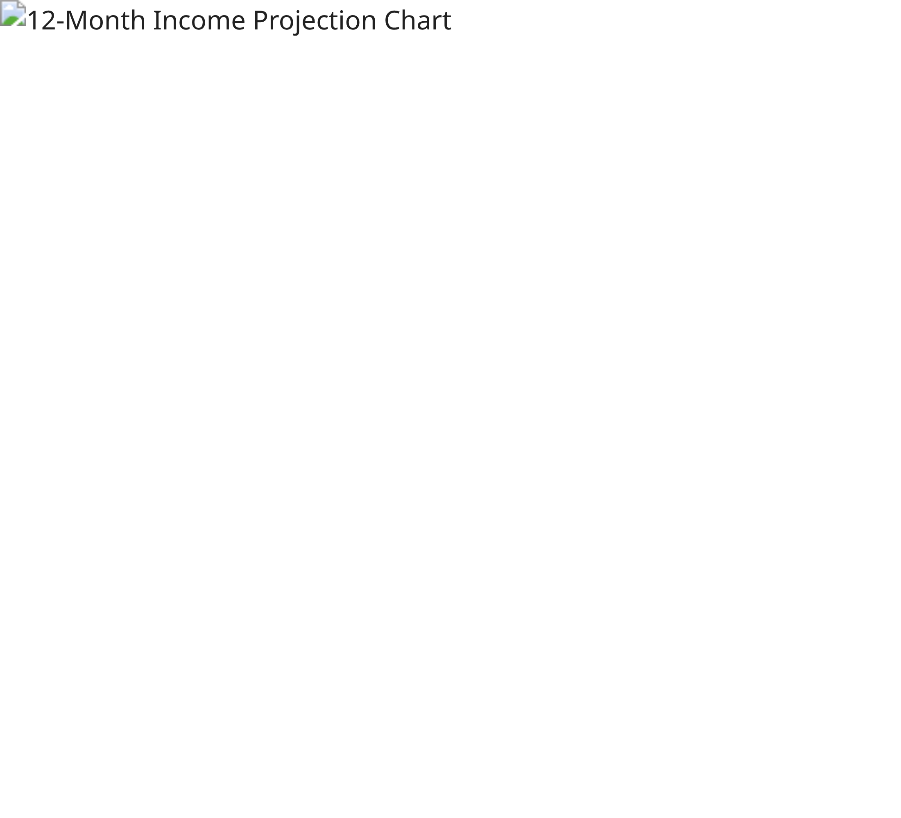
Financial Projections
12-Month Income Projection
Etsy Store
Starting with digital products, scaling to AUD 2,100/month by month 12
TikTok Affiliate
Building audience and affiliate partnerships to reach AUD 1,500/month
Drone Videography
Beginning in month 8, growing to AUD 2,500/month by month 12
Target Monthly Income:
AUD 2,000–5,000
Projected Month 12 Total:
AUD 6,100

Slide 10
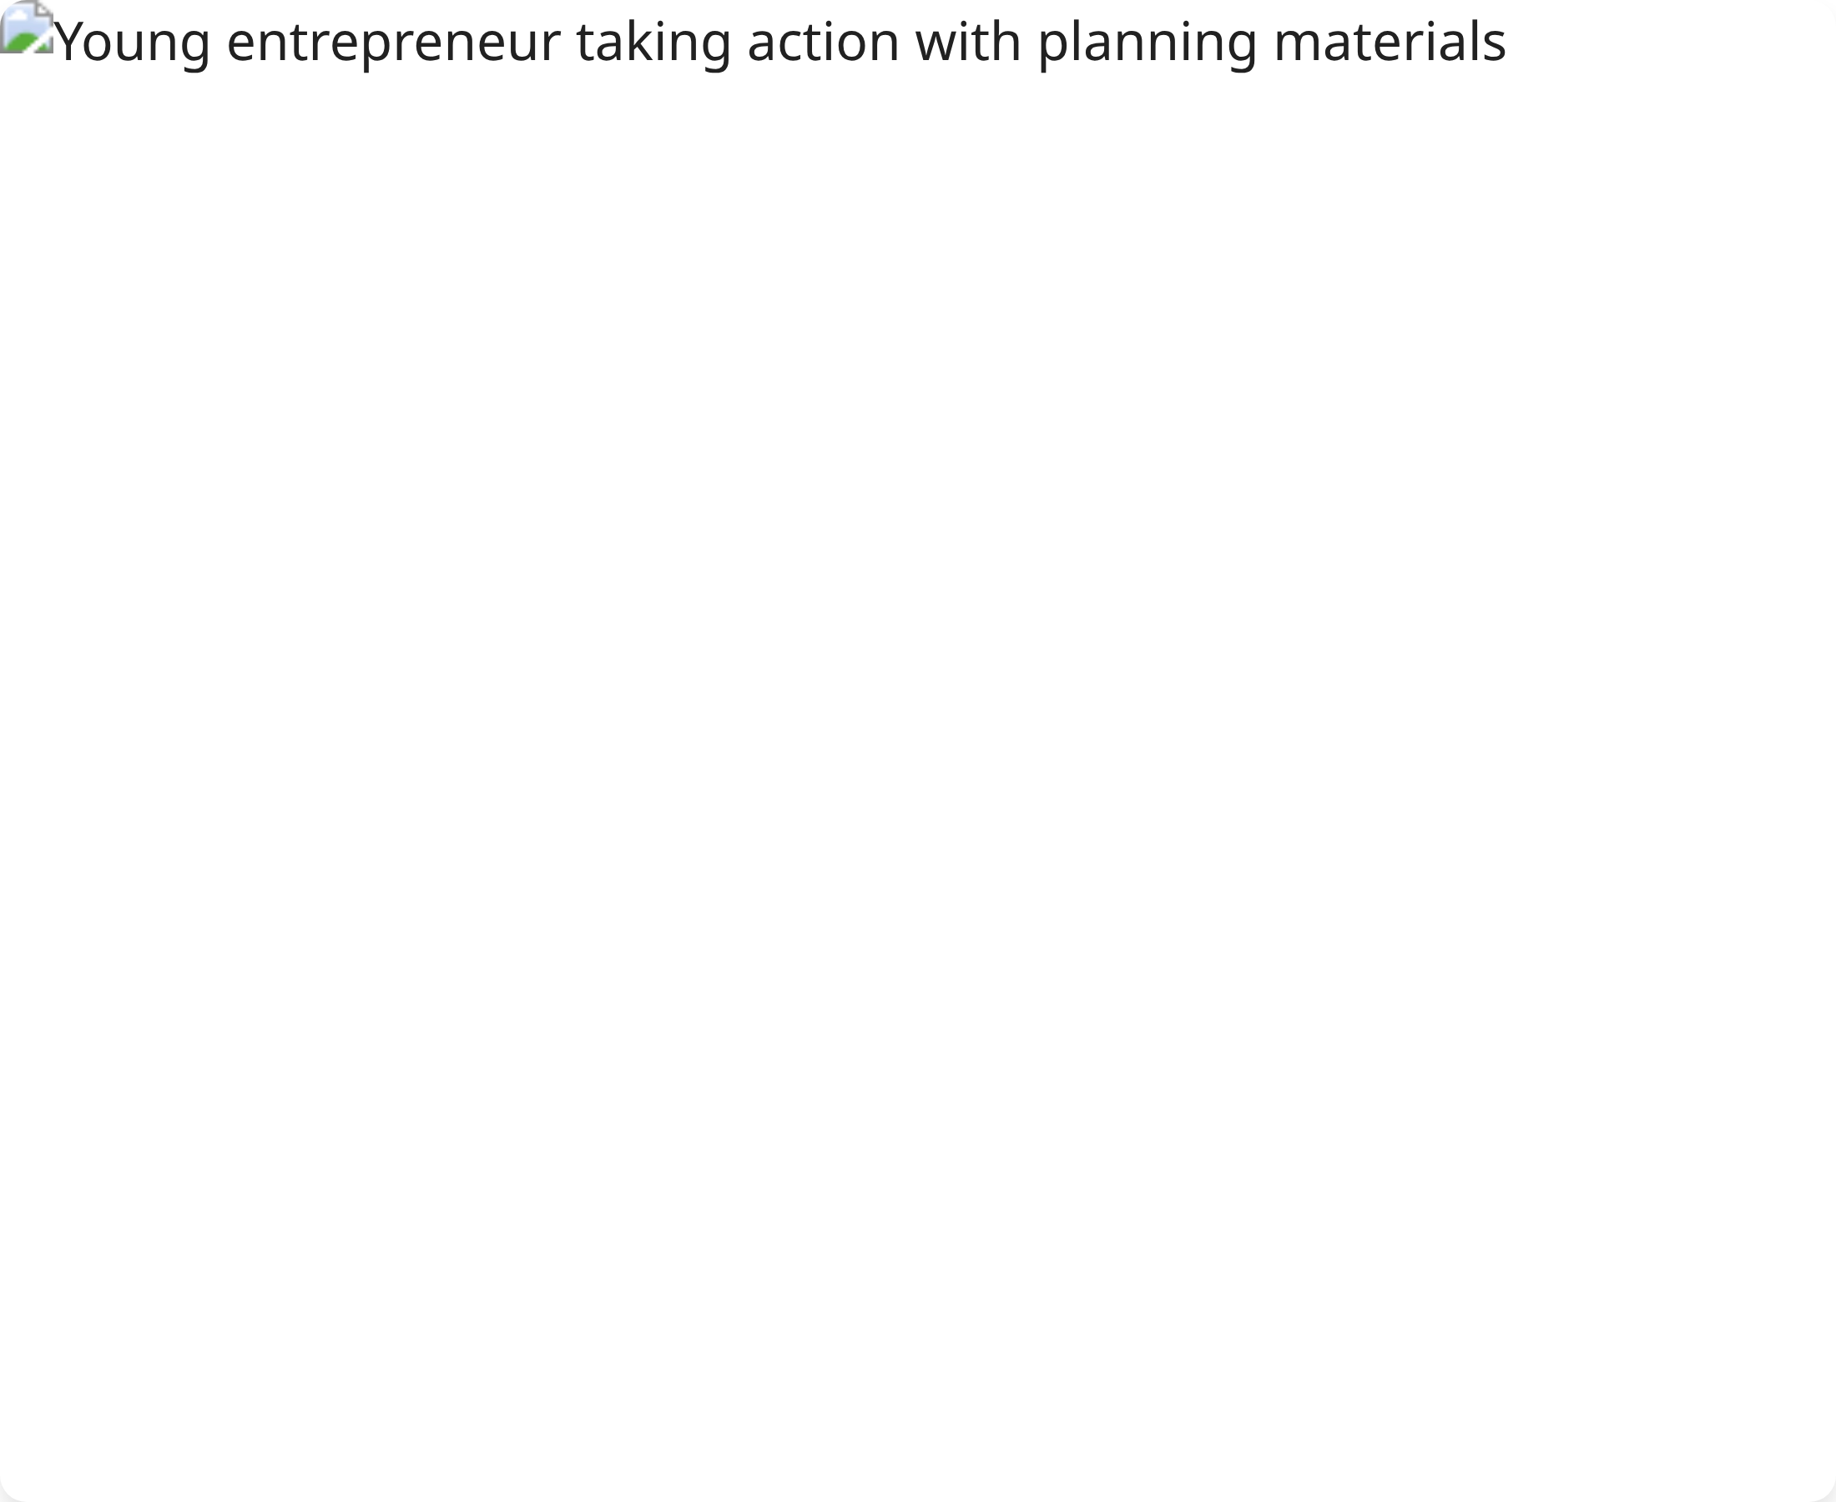







Next Steps & Resources
Immediate Action Items
Complete market research for Etsy map niches
Register Etsy shop and optimize profile
Design first three map products
Create TikTok business account and first content
Key Resources
Comprehensive Strategic Plan Document
30-Day Implementation Plan Spreadsheet
3-Month Drone Implementation Timeline
Financial Projections & Tracking Tools

